Slide 1
Technology and the End(?) of Auto Insurance
September 2016
834680
Donald Light
dlight@celent.com

Slide 2
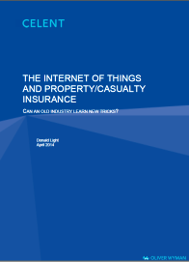
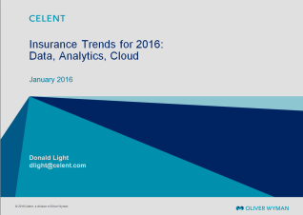
Celent: The leading global insurance technology analyst firm
A knowledge-based intermediary working with
Two Core Offerings
Organizational Family
Insurers
Technology firms
Strategic consultants
Technology investors
Research Reports bridging technology and business
Technology consulting
A division of
A member of

Slide 3
What is going to reduce auto accidents and auto insurance premiums?
Three technologies will increasingly reduce auto losses
Telematics
Advanced Driver Assistance Systems (ADAS)
Driverless cars
Other givens and trends will also play a role
Human error is the root cause of most auto losses
Kinetic Energy = Mass X Velocity² X ½
The Shared Economy
V2V (Vehicle to Vehicle) and V2I (Vehicle to Infrastructure)
Auto OEMs prioritizing Connected Cars
The outlook
Private passenger auto losses and premiums will decline in a material way from 2015 to 2030
One Conclusion
By 2030, if not before, auto insurers will face some hard choices—as will auto OEMs—as will dealers

Slide 4
Driverless cars’ impact and incidence
Celent believes driverless cars will be highly effective at lowering insured losses
Regulatory (and political) scrutiny of this radically new technology makes it very likely that permission for general use will depend on a very high level of safe operation
There will be bumps along the way, including:
Human:Machine handoffs in emergencies
Systems failure (all systems fail at some frequency)
Auto OEMs must make driverless cars attractive enough to sell in high numbers
Many disputes over shared responsibility: driver, auto manufacturer, driverless car technology providers, infrastructure providers, and . . .
Most/all comprehensive coverage claims (hail, trees falling on cars, etc.) will of course still occur
Despite gathering 99.9% of the “car of the future” hype, driverless cars will have only a minor impact on losses for at least the next 10 years

Slide 5
A Celent timetable for technologies that will reduce insurance losses and insurance premiums
2015
2016 to 2020
2021 to 2025
2026 to 2030
Widespread Use
Stronger Awards and Penalties Plus Government Mandates
Telematics
Advanced Driver
Assistance Systems
More Use
Consumers Respond to Awards and Penalties
Telematics
Driverless Cars
Telematics
Advanced Driver
Assistance Systems
Driverless Cars
Limited Use
Consumers Decide
Advanced Driver
Assistance Systems
Driverless Cars

Slide 6
Thank you
Regarding the content of today’s presentation, or for copies of the presentation; please contact Donald Light, dlight@celent.com
General questions about accessing other Celent material
Please contact Celent Business Development Manager, Chuck Smith, csmith@celent.com

